Slide 1
Project Presentation of Web Development
On
JOB ASPIRE
Arpita 2210991359
Arshika 2210991369
Kanika 2210991735
Rishika 2210992164
Supervised By
Mr.Sudeep
Department of Computer Science and Engineering,
Chitkara University, Punjab

Slide 2
Introduction
A robust backend system designed to streamline job portal operations efficiently.
Provides seamless handling of job postings, employer profiles, and candidate applications.
Designed with a scalable architecture, capable of supporting a growing number of jobs, companies, and users.
Optimized for high-performance querying, minimizing response times for job searches and application tracking.
Implements secure user authentication and role-based access for job seekers, employers, and administrators.

Slide 3
Problem Statement
Managing job portals involves a variety of operational complexities, including job postings, candidate applications, and employer-candidate interactions. Traditional approaches often suffer from inefficiencies due to:
Lack of real-time updates on job postings and application statuses, leading to missed opportunities.
Difficulty in managing user data securely, impacting trust and compliance. Inefficient application tracking and matching systems, creating frustration for both job seekers and employers.
Inconsistent user experience across multiple platforms, reducing engagement.
Our JobAspire solution aims to centralize these functionalities into one efficient platform, ensuring seamless operations, real-time updates, and an enhanced user experience for both job seekers and employers.

Slide 4
Technologies Used
Frontend:
  HTML, CSS, JavaScript: Core web technologies for structure, styling, and interactivity.
  React.js: Builds dynamic and responsive user interfaces with reusable components.
Backend:
  Node.js: Handles server-side logic and API creation.
  Express.js: Manages routing and efficient handling of requests.
Database:
  MongoDB: NoSQL database for storing user data and social interactions.
  Mongoose: Simplifies database interaction by managing data models and schemas.

Slide 5
Purpose of the Project
Simplify job postings, candidate applications, and employer interactions through a unified platform.
Ensure secure and scalable storage of large volumes of user and application data.
Provide seamless job searching, resume uploads, and application tracking features.
Offer real-time updates on job postings, application statuses, and employer responses.
Deliver a consistent and accessible user experience across devices.
Design a system that can handle increasing traffic and user activity efficiently.

Slide 6
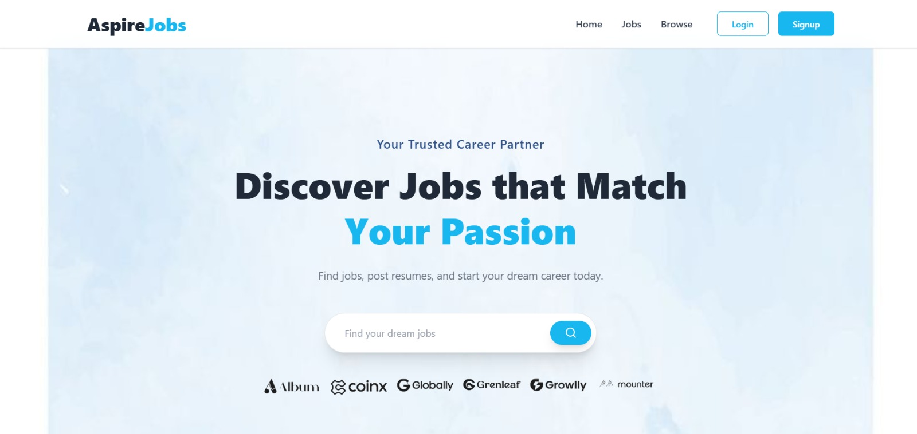
Screenshots

Slide 7
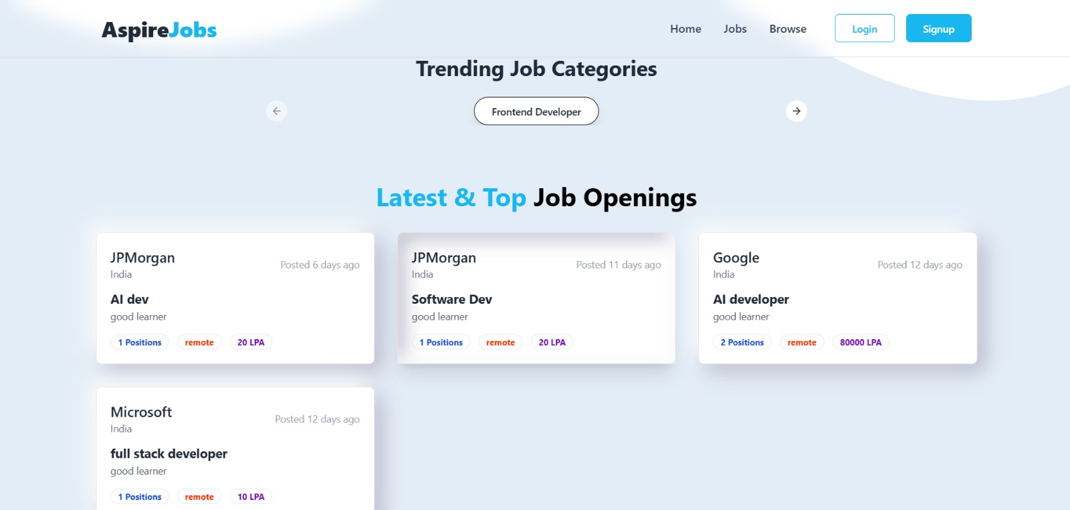
Screenshots

Slide 8
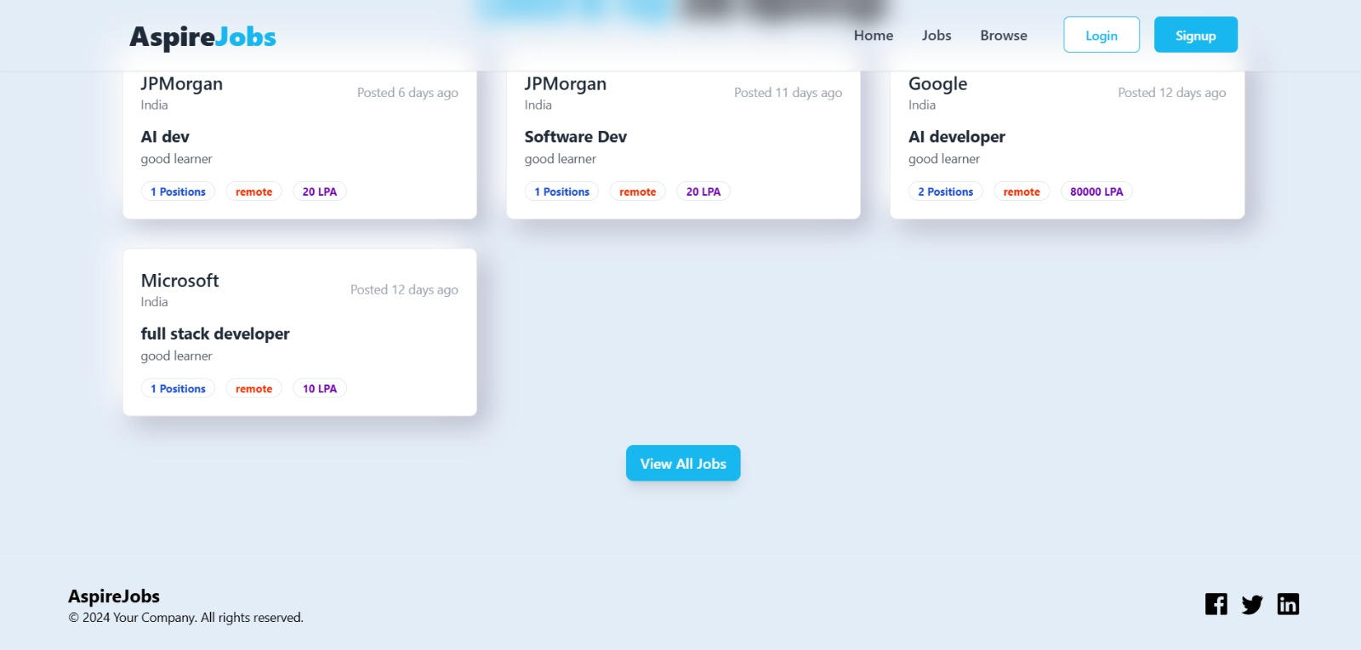
Screenshots

Slide 9
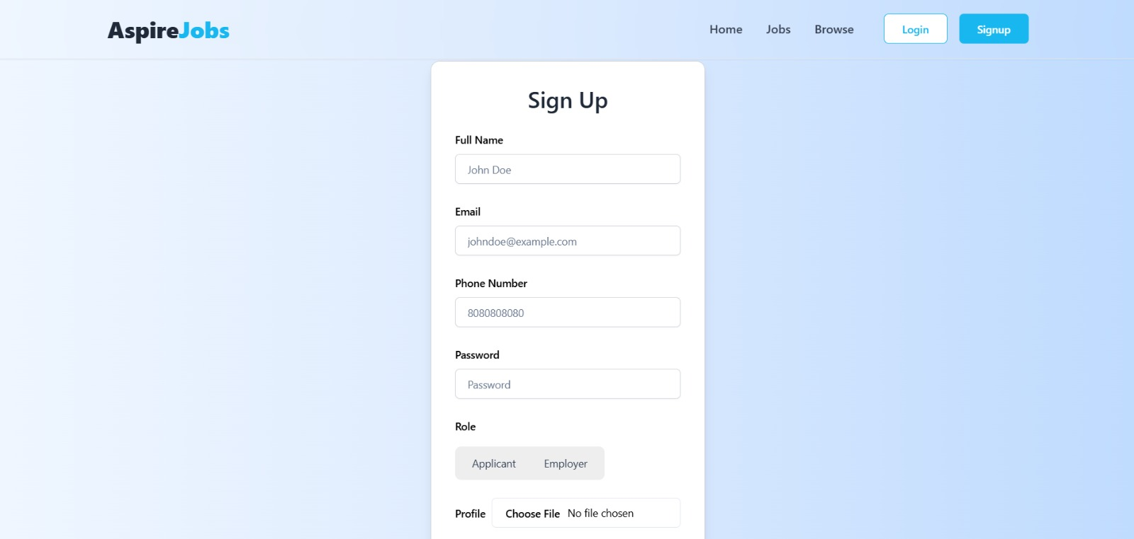
Screenshots

Slide 10
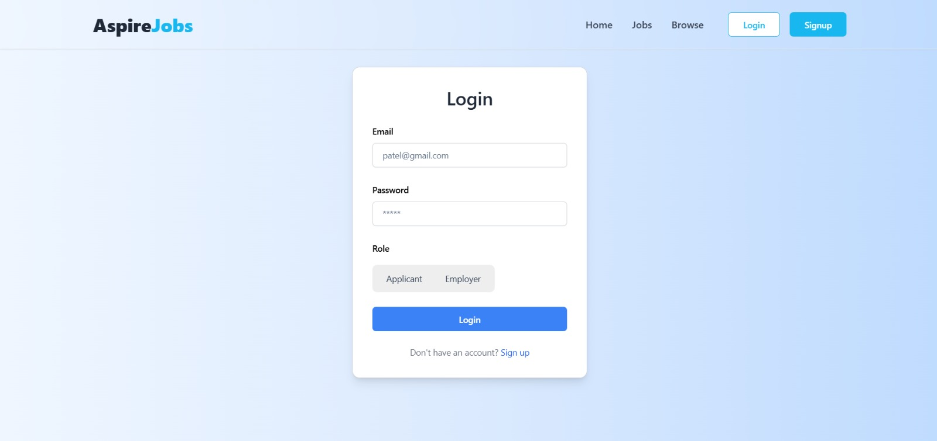
Screenshots

Slide 11
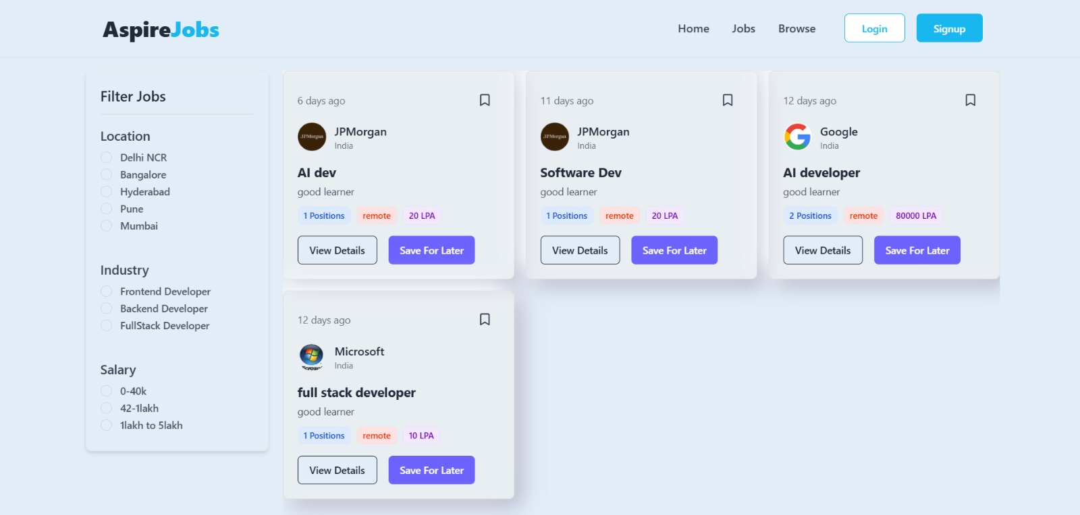
Screenshots

Slide 12
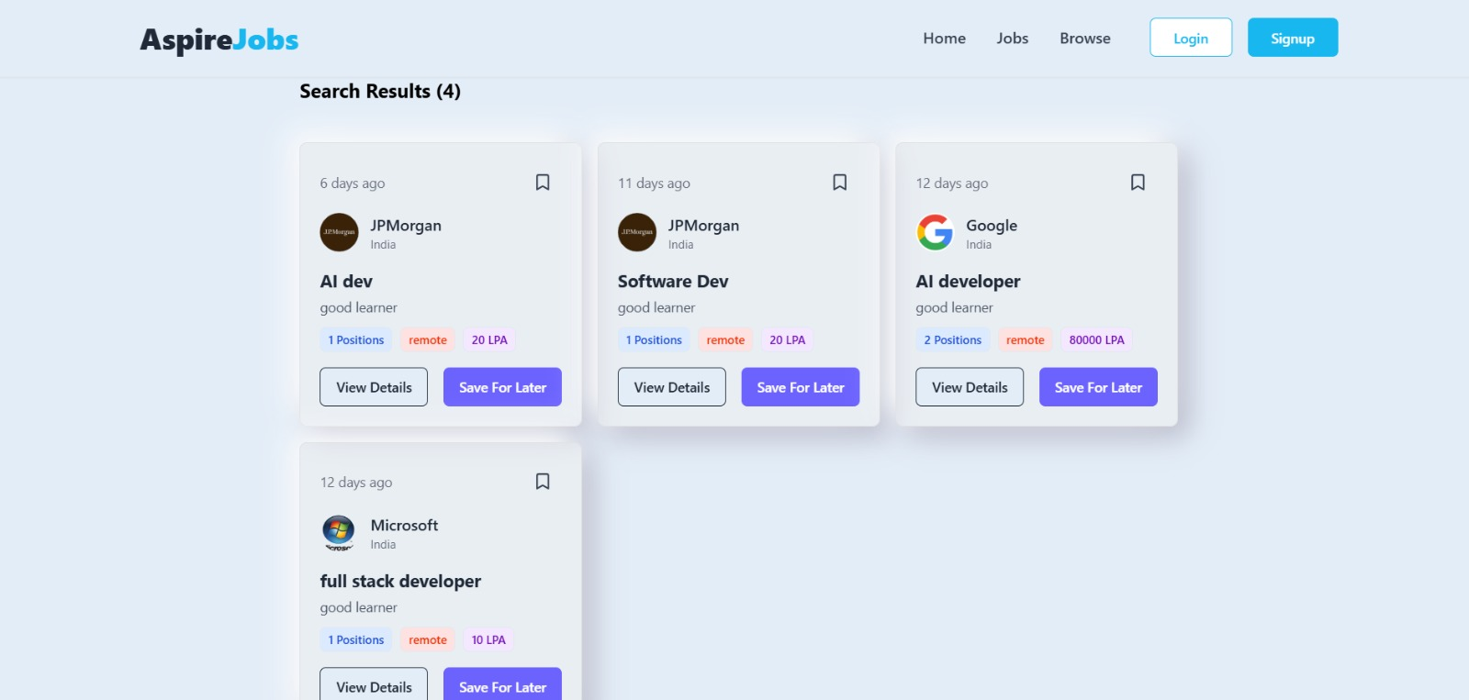
Screenshots

Slide 13
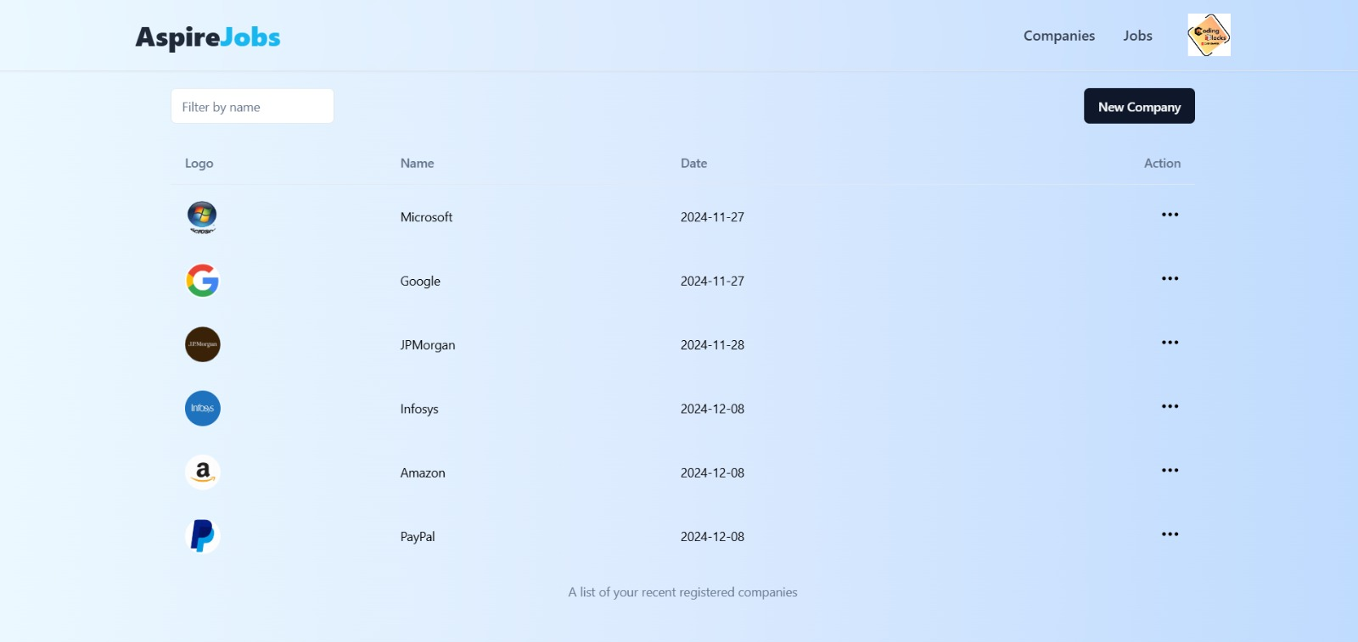
Screenshots

Slide 14
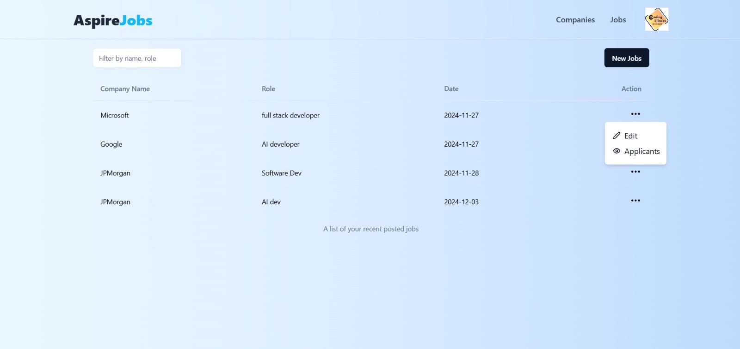
Screenshots

Slide 15
Future Improvements
Real-time Communication
Server-Sent Events (SSE): Instead of WebSockets, beginners can start with SSE, which allows the server to push updates to the client over HTTP. This is easier to implement for simple real-time notifications.
Polling: A basic method where the client periodically requests updates from the server at regular intervals, useful when WebSockets or SSE aren't set up.
Socket.io: A library built on top of WebSockets that simplifies real-time communication in Node.js, making it easier for beginners to add real-time chat, notifications, or live updates.
Security
Security enhancements will include multi-factor authentication (MFA) to provide an extra layer of protection beyond passwords, ensuring only authorized users access accounts.
Additionally, encrypted data storage will be used to safeguard sensitive user information, protecting it from unauthorized access and breaches.

Slide 16
Conclusion
The JobAspire project showcases the potential of modern web technologies in revolutionizing the job search and recruitment process.
A seamless interface ensures that job searching, application submissions, and employer interactions are easy and intuitive.
Built with a robust tech stack, including React.js, Node.js, and MongoDB, the platform delivers high performance, scalability, and reliability.
Future updates may include AI-driven job recommendations, advanced analytics for employers, and enhanced real-time status tracking for applications.
This platform is well-positioned to transform the way users engage with the job market, making the process more efficient and user-friendly.

Slide 17
Thank You

